Slide 1
Predicting
Notes:
Say: Today we’re going to work on the comprehension strategy of predicting.

Slide 2
prediction to predict
predict the outcome
predict the future
predict the effect
able to predict
difficult to predict
make a prediction
accurate prediction
Notes:
Say: This is how the word predict is commonly used. Please repeat after me
Do: Teacher say each phrase and have students repeat.

Slide 3
Rate your Knowledge
1. I don’t know it.
2. I’ve heard it, but I don’t know the meaning.
3. I can use it in a sentence.
4. I can teach it to the class.
Notes:
Say: How well do you know this word?
Do: Read the ranking system, have students hold up a finger that represents their knowledge.
Say: Okay, I see some different numbers let’s get everyone to a 4!

Slide 4
Definition
To predict is to say what you think will happen in the future usually based on facts and evidence. To say (dict) something before (pre) it happens.
Notes:
Do: Read definition and point out the root dict means to say and pre means before, so to literally say before it happens.

Slide 5
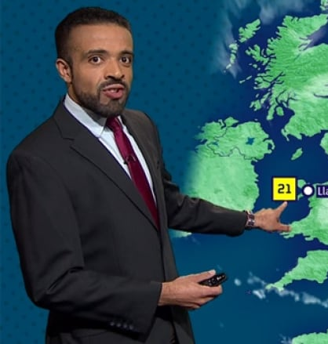
Example
It’s been hot, and the weatherman predicts it’s going to be 100 degrees this weekend!
Notes:
Say: An example of this is the weatherman predicting the weather. He definitely uses evidence to predict what the weather will be like in the future.

Slide 6
Metacognition Activity (thinking about how we think)
Pass out “Thinking about HOW we THINK”
Watch The Ladle Drops (Next Slide)
Stop the clip at 1:22
Make a prediction on your paper about what will happen in the future. Practice saying it in the frame.
Think about how and why you came up with your prediction.
Did you need to understand what was happening in the clip?
Did you have to make an inference about how people felt?
Notes:
Say: Now we are going to make some predictions and think about how we do this, what our mind is doing when we make predictions.
Do: Pass out and review Thinking about How we Think. You will watch the clip from “The Ladle Drops” and stop it at 1:22.
After you Stop Clip at 1:22 seconds Say: Okay, now you will make a prediction about what you think will happen next and WHY you think that. When you finish practice saying it in the frame and be prepared to share HOW you arrived at your prediction (go over bullet points).
Do: Monitor and assist as needed.

Slide 7
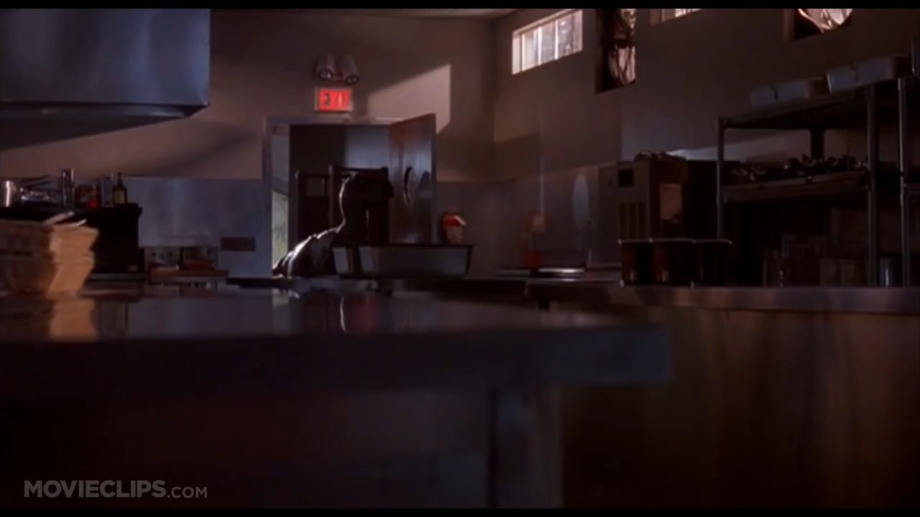
The Ladle Drops

Slide 8
Metacognition Activity
Share out predictions and thought processes.
Watch remainder of clip.
Did it make it more enjoyable to watch with a prediction in mind?
Did you predict accurately?
Remember! A good, strong prediction can still be inaccurate.
Notes:
Say: Before we watch the rest of the clip let’s share out our predictions as well as our thought process.
Do: Watch remainder of clip or from the beginning.
Say: Let’s share out about our predictions. First of all, did it make it enjoyable to watch with a prediction in mind? Yes! When our mind is actively engaged it does make things more enjoyable. Who predicted accurately? Raise your hands. This is very important, you all had good, strong predictions. I heard them—they were all logical and made sense that is our goal. They may or many not be in line with what actually happens, or accurate, but that is absolutely okay.

Slide 9
Guiding questions to think about how you think:
What is your prior knowledge? (dinosaurs, plots of movies, genres, music, characters)
Does prior knowledge affect the type of prediction you make?
Should you base it only on prior knowledge? For example, “I have seen a friendly dinosaur in a tv show, so I predict this dinosaur is going to see the kids and try to raise them as its own.”
Is that a strong prediction? Why or why not?
Notes:
Do: If needed here are some additional guidelines for helping students think about how they come up with strong predictions.

Slide 10
Prediction Additional Guidance
Inference vs. Prediction
Inference is happening right now, but a prediction is about something that will happen in the future.
The text type will dictate what you predict
Narrative text? Predict what happens next.
Expository text? Predict what the text will be about next.
Current event? Predict how this will impact society in the future.
Historical event? Predict how it impacted society in the immediate future, from when the text was written.
Notes:
Do: This is an optional slide, but if students are experiencing confusion about prediction vs. inference OR how to predict with various text types. This might be beneficial.

Slide 11




The contents of this presentation were developed under a State Personnel Development Grant (SPDG) from the US Department of Education (CALI/Award #H323A170011), Project Officer, Latisha.Putney@ed.gov. However, the contents of this presentation do not necessarily represent the policy of the US Department of Education and no assumption of endorsement by the Federal government should be made.

